Slide 1



Projet financé par l’Union Européenne
Projet mis en œuvre par Expertise France
Basics of a CSIRT: Managerial Aspects and Software environment
LAB session, Day 4
Accra, August 9 – 13, 2021
ORGANISED CRIME: WEST AFRICAN RESPONSE ON CYBERSECURITY AND FIGHT AGAINST CYBERCRIME
Notes:
1

Slide 2

Leonardo “Leo” Lanzi, GARR-CERT (IT)
Dr. Prof. Mrs. Adriana “auntie” Franca, The Security Brokers (IT)
All of the Network and Cybersecurity people at University of Bologna (IT)
Mrs. Rabiyatou “Rabi” BAH, (FR), for making this training happened (I was close to give up)
Almerindo Graziano, SilenSec, for the Cyber Ranges courtesy: kudos!
Benjamin Delphy aka Gentilkiwi, author or Mimikatz (aka kdll, kdllpipe, katz, mimikatz) (FR)
Paul Sparrows (Paolo Passeri) (IT)
Kevin “The Condor” Mitnick
Pete Herzog, ISECOM (USA, ES)
Peter Cassidy, APWG (USA)
Multiple security communities:
  ISECOM
  OWASP
  ICANN
  APWG
  INTERPOL
  TEAM CYMRU
  Hackmageddon.com
  Operation Trust / OPS-T
Credits

Slide 3
LAB session
Each participant will perform a couple of exercises.
The focus will be on some of those tools which were initially selected by the designers of this training.
Despite the “tools” aka “how” (remind the Security Onion concept I told you in details this morning), we focus on the “what”:
SCENARIO #1
SCENARIO #2

Slide 4
LAB session
HOW will we make it?
USB sticks with dedicated boot?
VMs?
Wasting time ‘cause of HW issues, config problems, etc?
NO WAY!
It’s 21st Century, you know?
I’ll give you a URL on which fill in the registration form, and KABOOM!!! A New World for you guys and ladies ☺
It’s the new way to train trainers and students.
It’s named Cyber Ranges.
And now… a special surprise!

Slide 5
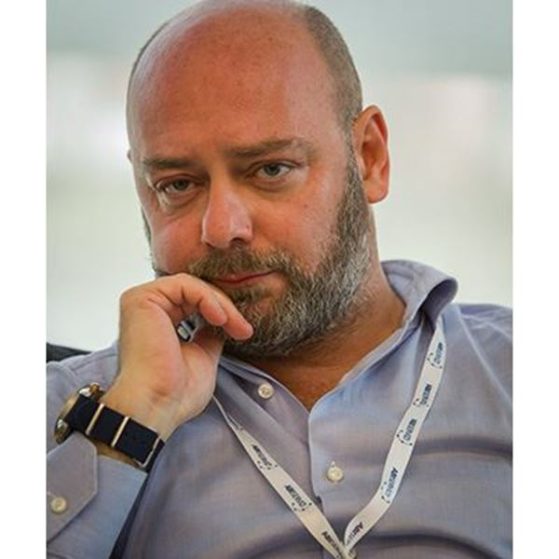
Managerial Aspects and Software environment
Thank you
Contact:
Raoul Chiesa
Cybersecurity Expert
rc@security-brokers.com
Notes:
5
5

Slide 6

^{OCWAR-C}
12 Charles de Gaulle Street Asokoro,
^{Abuja - NIGERIA}
^{contact@ocwarc.eu}
Notes:
6

